Slide 1

London Borough of Harrow Pension Fund
2016 Valuation: Funding strategy considerations
Gemma Sefton
9 March 2016

Slide 2
What are we going to cover?
Actuarial valuation basics
Valuing the Fund
Recap of 2013 valuation funding strategy
Developments for 2016 valuation

Slide 3
Intro to the valuation

Slide 4
Why do we do a valuation?
Compliance with legislation
Set employer contribution rates
Determine money needed to meet accrued liabilities
Calculate solvency (“funding level”)
Monitor experience vs. assumptions
Manage risks to Fund and employers
Review the Funding Strategy Statement (FSS)

Slide 5
The Fund’s ultimate objective
Structure
Managers
Pension Amounts (£) Millions
Year
Pay members’ benefits
Source: London Borough of Harrow Pension Fund 2013 formal valuation cashflows

Slide 6
How the fund works
Investment income/growth**
£90m
Employer contributions
Pensions
Lump sums
Employee contributions
Transfers in
Transfers out
£29m
£34m
Expenses*
£1m
* Investments and administration
** Income and growth
Source: LB Harrow Pension Fund Annual Report and Accounts 2014/15

Slide 7


Promise now, pay later: Long term pension promise in ever-changing environment
Lump Sum
Contributions
Expenditure
Member’s Pension
Dependant’s
Pension
Income
40
65
85
Recruitment
Retirement
Death

Slide 8
Scheme benefits – the building blocks
Final pay in
last year
Period of
Scheme
Membership
Accrual
rates
Basic pay/salary
Time in the LGPS
Pre-2008
1/80th
Extras – bonus,
overtime, benefits in
kind
Transferred in
Post-2008
1/60th
Pay during
each year
Bought by the
member
Post-2014
1/49th
Basic pay/salary
Awarded by
the employer
Extras – bonus,
Overtime, benefits in
kind

Slide 9
Overview of a valuation
Actual cost of a Scheme will depend on the pensions actually paid
A valuation is an estimate of how much money will be needed to pay the pensions
Estimate is based on assumptions about
  amounts of benefit payments
  probability of benefits being paid

Slide 10
The actuarial valuation: interested parties
Councils/Taxpayers
want employees’ benefits suitably funded, with minimal impact on Council services, and minimal inter-generation cross-subsidies
Pension Committee
formally decides on appropriate balance between prudent funding of Members’ benefits and affordable contributions which are consistent across all Employers
Employers
wish affordable, stable contributions which pay for their employees’ benefits and are consistent with other employers
Actuary carries out valuation
Local Pension Board
oversees process, assists Pension Committee where necessary
Fund members
must have their benefits paid in full. Want to see their Fund run well: look to Officers, Committee and Local Pension Board
Officers
liaise closely with Actuary and other advisers, Pensions Committee, and Employers
Investment adviser
considers valuation projections relative to Fund’s investment strategy

Slide 11




Valuation timeline
Early 2016
Funding strategy discussions and valuation planning.
May – July 2016
Data submitted and whole fund calculations processed.
[Send draft results to National Scheme Advisory Board by 30/9]
July 2016
Initial results and assumptions discussed and agreed with Fund.
August 2016
Individual employer results calculated.
September - December 2016
Employer results and funding strategies agreed in principle.
Employer forum and surgeries held.
February 2017
End of employer consultation.
Final employer results and FSS
agreed.
March 2017
Final valuation report signed off by 31 March 2017.

Slide 12
Valuing the Fund

Slide 13


Liability valuation - assumptions
Amounts paid and probability of payment
Financial assumptions:
Investment return
Inflation
Pay increases
Pension increases
Consider:
Economic outlook
Actual scheme assets
Historical pay growth
Demographic assumptions:
Life expectancy
Retirement age and cause
Withdrawals
Marriage statistics
Consider:
Population trends
Members’ social status
Past scheme experience

Slide 14
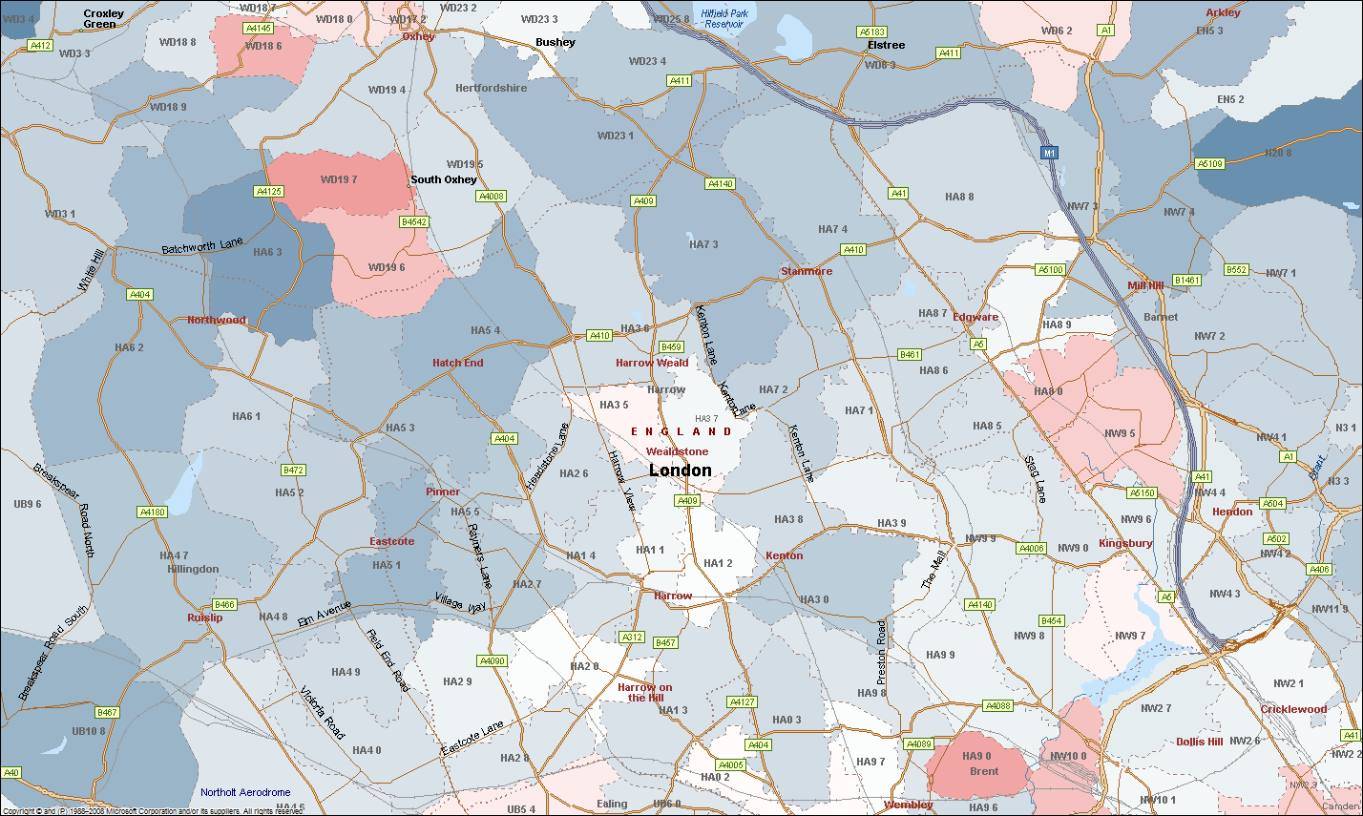
Granularity of Fund membership
High life expectancy
Mid life expectancy
Low life expectancy

Slide 15
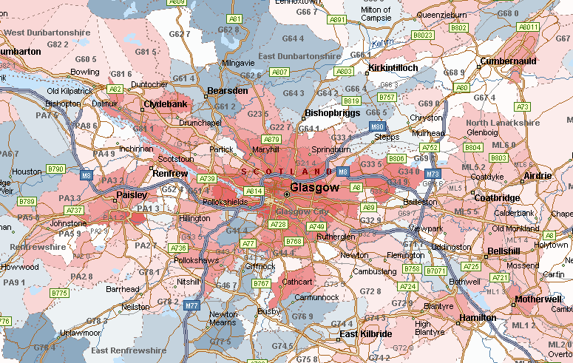
Each Fund is different
High life expectancy
Mid life expectancy
PH1 2AF
Low life expectancy
PH1 2AE
Source: Club Vita research based on VitaBank as at January 2012

Slide 16
Traditionally: funding plans based on single expectation of the future
Actuary & Fund agree one set of assumptions
Actuary calculates contribution rates

Slide 17
Recap of 2013 approach

Slide 18


LB Harrow Pension Fund approach
Measurement and management of funding position
Measure:
Assets and liabilities valued using market conditions
Ensure transparency and consistency
Understand deficit
Appreciation of risk
Manage:
Balance affordability and risk
Recognise risk posed by different employers
Consider term of participation
Consider different future outcomes for market conditions

Slide 19
LB Harrow Pension Fund: risk based approach to setting council contribution strategy
Assess the likelihood of different outcomes

Slide 20
5,000 scenarios gives a distribution of outcomes
200%
175%
1 in 6 chance
150%
125%
Funding Level (%)
Median
100%
75%
1 in 6 chance
50%
25%
0%
0
3
6
9
12
15
18
Years from valuation date
More than 50% chance meet funding objective
Source: Hymans Robertson LLP, comPASS, sample output

Slide 21
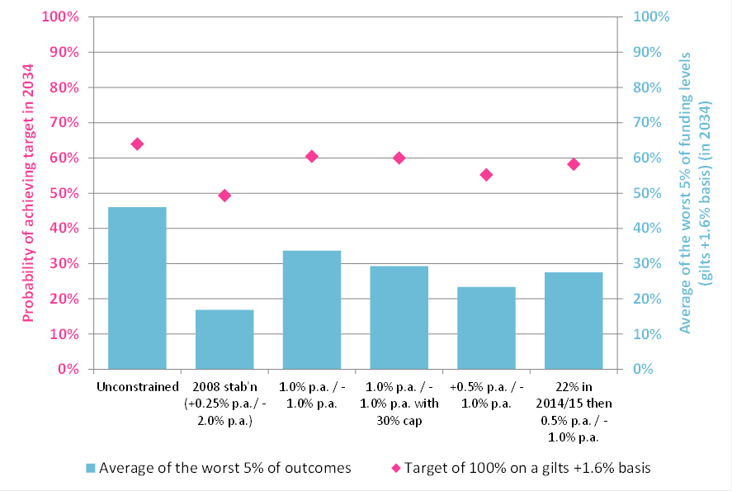
LB Harrow Pension Fund:
understanding future risks
Ideally want the bars and the points to be as high as possible
Source: Hymans Robertson LLP, comPASS, LB Harrow modelling (2013)
Notes:
Probability of achieving target in 2034, risk in 2034
Q:\Client Projects\Cheshire CHES01\2013 ALM\Cheshire East\130226 CHES CheshireEast New Full Cashflow ALM.xlsm @ 07/03/2013 16:19:41
+/- 0.5% p.a. (Current) (Scenario 1; Current; +/- 0.5% p.a. (Current); 0)
Fixed 23% (Current) (Scenario 3; Current; Fixed 23% (Current); 0)
+ 2.0%/- 1.0% p.a. (Current) (Scenario 7; Current; + 2.0%/- 1.0% p.a. (Current); 0)
+ 2.0%/- 1.0% p.a. with a 28% cap (Current) (Scenario 5; Current; + 2.0%/- 1.0% p.a. with a 28% cap (Current); 0)
Fixed 23% (70% growth) (Scenario 4; Alt Inv 1; Fixed 23% (70% growth); 0)
+ 2.0%/- 1.0% p.a. (70% growth) (Scenario 2; Alt Inv 1; + 2.0%/- 1.0% p.a. (70% growth); 0)
+ 2.0%/- 1.0% p.a. with a 28% cap (70% growth) (Scenario 6; Alt Inv 1; + 2.0%/- 1.0% p.a. with a 28% cap (70% growth); 0)

Slide 22
LB Harrow Pension Fund: understanding the trade offs
CONTRIBUTION STRATEGY | Prudence |  | Stewardship | Affordability
 | LONG TERM LIKELIHOOD OF SUCCESS | AVERAGE OF THE WORST 5% OF FUNDING LEVELS IN 2035 | MEDIAN FUNDING LEVEL IN 22 YEARS | HIGHEST MEDIAN CONTS DURING THE NEXT 22 YEARS
Strategy 1 | 78% | 39% | 170% | 20.7%
Strategy 2 | 77% | 55% | 146% | 27.0%
Strategy 3 | 63% | 45% | 120% | 20.7%
Strategy 4 | 50% | 47% | 105% | 21.7%
Strategy 5 | 70% | 50% | 163% | 20.5%
Strategy 6 | 77% | 52% | 161% | 22.7%
Source: Hymans Robertson LLP, comPASS, sample output

Slide 23
2013 contribution rate strategies
Type of employer | Scheduled Bodies |  | Community Admission Bodies and Designating Employers |  | Transferee Admission Bodies
Sub-type | Council Pool | Academies | Open to new entrants | Closed to new entrants | (all)
Basis used | Ongoing, assumes long-term Fund participation (see Appendix E) |  | Ongoing, but may move to “gilts basis” - see Note (a) | Ongoing, but may move to “gilts basis” - see Note (a) | Ongoing, assumes fixed contract term in the Fund (see Appendix E)
Future service rate | Projected Unit Credit approach (see Appendix D – D.2) |  | Projected Unit Credit approach if open (see Appendix D – D.2) | Attained Age approach (see Appendix D – D.2) | Projected Unit Credit approach if open, Attained Age otherwise (see Appendix D – D.2)
Stabilised rate? | Yes - see Note (b) | Yes - see Note (b) | No | No | No
Maximum deficit recovery period – Note (c) | 20 years | 20 years | 15 years – subject to security / covenant check | 15 years – subject to security / covenant check | Outstanding contract term
Deficit recovery payments – Note (d) | Monetary amount | Monetary amount | Monetary amount | Monetary amount | Monetary amount
Treatment of surplus | Covered by stabilisation arrangement | Covered by stabilisation arrangement | Preferred approach: contributions kept at future service rate. However, reductions may be permitted by the Administering Authority |  | Reduce contributions by spreading the surplus over the remaining contract term
Phasing of contribution changes | Covered by stabilisation arrangement | Covered by stabilisation arrangement | None | None | None
Review of rates – Note (f) | Administering Authority reserves the right to review contribution rates and amounts, and the level of security provided, at regular intervals between valuations |  |  |  | Particularly reviewed in last 3 years of contract
New employer | n/a | Note (g) | Note (h) |  | Notes (h) & (i)
Cessation of participation: cessation debt payable | Cessation is assumed not to be generally possible, as Scheduled Bodies are legally obliged to participate in the LGPS. In the rare event of cessation occurring (machinery of Government changes for example), the cessation debt principles applied would be as per Note (j). |  | Can be ceased subject to terms of admission agreement. Cessation debt will be calculated on a basis appropriate to the circumstances of cessation – see Note (j). |  | Participation is assumed to expire at the end of the contract. Cessation debt (if any) calculated on ongoing basis. Awarding Authority will be liable for future deficits and contributions arising.

Slide 24
Development of 2016 strategy

Slide 25



3 step approach to setting funding plans
What is our funding target?
How long do we want to give ourselves to get to the target?
How sure do we want to be that we hit the target?

Slide 26
Employers are different
No actives
Term
Maturity
Security
Size
Guarantor
Closed to new entrants
Planning to exit
Funding level
Set a funding strategy which recognises this diversity to achieve better funding outcomes

Slide 27


What this looks like in practice
Help all parties understand approach to setting contribution rates (including SAB and DCLG)
Transparent approach to funding plans

Slide 28
Development for 2016: risk based contribution rates
The ‘old’ world
The ‘new’ world
CONTRIBUTION STRATEGY | LONG TERM LIKELIHOOD OF SUCCESS | AVERAGE OF THE WORST 5% OF FUNDING LEVELS IN 2035
Strategy 1 | 58% | 39%
Strategy 2 | 77% | 55%
Strategy 3 | 67% | 45%
Bespoke risk based contribution rate strategies set for selected high risk employers

Slide 29
2016 valuation
More scrutiny than ever before
Audit control and clear decision making processes
Employer communications will be key
Timescales are challenging
Risk based contribution rates for all employers

Slide 30
Thank you

Slide 31
Appendix

Slide 32

Discount rate: assumed future investment return
Discount rate = 4.6%
Outperformance
Gilt yield
3.0%
1.55%
Set the target assets wisely
Also the interest rate for any deficit
Discount rate = bond yield plus allowance for expected outperformance
Notes:
REMINDER
EXPLAIN DISCOUNT RATE – EXPECTED FUTURE INVESTMENT RETURN – IF EARN LOWER FUTURE RETURNS NEED TO PUT MORE MONEY INTO FUND TO PAY FOR BENEFITS
WHY USE BOND YIELDS AS REFERENCE POINT?
Predictable future return (if buy and hold)
Consistent yardstick
Liabilities and bonds similarly influenced
Pure bond yield likely to be too expensive
Discount rate includes allowance for expected outperformance of Fund’s assets
May use bond yield (without allowance for outperformance) as the discount rate in special situations (eg legacy liabilities)

Slide 33
Value today of £100 in 10 years time
Future Inflation | In 10 years £100 grows to | Assumed future investment return | How much cash do I need today
Zero | £100 | 7% | £48
3% | £134 | 7% | £65
3% | £134 | 5% | £80
Higher inflation, lower future investment return,
need more cash today
Notes:
REMINDER
EXPLAIN DISCOUNT RATE – EXPECTED FUTURE INVESTMENT RETURN – IF EARN LOWER FUTURE RETURNS NEED TO PUT MORE MONEY INTO FUND TO PAY FOR BENEFITS
WHY USE BOND YIELDS AS REFERENCE POINT?
Predictable future return (if buy and hold)
Consistent yardstick
Liabilities and bonds similarly influenced
Pure bond yield likely to be too expensive
Discount rate includes allowance for expected outperformance of Fund’s assets
May use bond yield (without allowance for outperformance) as the discount rate in special situations (eg legacy liabilities)

Slide 34
Value of Pension Fund Liabilities:
How much money do I need today?
30 years
£1,000 p.a.
60
90
Capitalised cost ignoring interest = £30,000
Capitalised cost allowing for interest¹ = £14,100
Capitalised cost allowing for interest and inflation² = £20,100
^{1,2} Assume 6% investment return and 3% inflation
.. and allow for probability of survival

Slide 35
Reliances and Limitations
This presentation is addressed to the London Borough of Harrow Council for its sole use as Administering Authority and not for the purposes of advice to any other party; Hymans Robertson LLP makes no representation or warranties to any third party as to the accuracy or completeness.
This presentation discusses the current issues in the LGPS and was prepared purely for illustration to employers. Hymans Robertson LLP accepts no liability for any other purpose of this presentation.
The following Technical Actuarial Standards* are applicable in relation to this presentation and have been complied with where material:
  TAS R – Reporting;
  TAS D – Data;
  TAS M – Modelling; and
  Pensions TAS.
* Technical Actuarial Standards (TASs) are issued by the Financial Reporting Council and set standards for certain items of actuarial work, including the information and advice contained here.

